Slide 1
Objectives
In this session, you will learn to:
  Read data from the console
  Write data to the console
  Describe files and file I/O
  Describe the JFC Swing technology
  Define Swing
  Identify the Swing packages
  Describe the GUI building blocks
  Examine top-level, general-purpose, and special-purpose properties of container
  Examine components

Slide 2
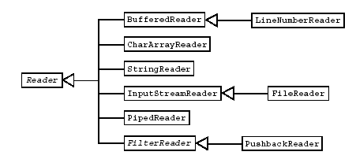
Basic Character Stream Classes
The following figure displays the hierarchy of Reader character stream classes in the java.io package.

Slide 3
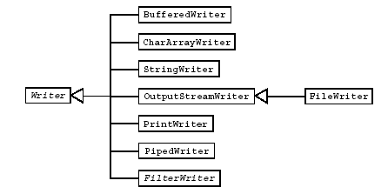
Basic Character Stream Classes (Contd.)
The following figure displays the hierarchy of the Writer character stream classes in the java.io package.

Slide 4
Basic Character Stream Classes (Contd.)
InputStreamReader and OutputStreamWriter classes are used to interface between byte streams and character readers and writers.
The FileReader and FileWriter classes are node streams that are the Unicode character analogues of the FileInputStream and FileOutputStream classes.
The BufferedReader and BufferedWriter class filter character streams is used to increase the efficiency of I/O operations.
The StringReader and StringWriter classes are node character streams that read from or write to Java technology String objects.
A PipedReader object in one thread receives its input from a complementary PipedWriter object in another thread.

Slide 5
Console I/O
Applications interact with the user using console I/O.
Java supports console I/O with three public variables in the java.lang.System class:
  System.out enables you to write to standard output. It is an object of type PrintStream.
  System.in enables you to read from standard input. It is an object of type InputStream.
  System.err enables you to write to standard error. It is an object of type PrintStream.

Slide 6
Writing to Standard Output
The System.out.println(String)method is used to write standard output.
The PrintStream() method prints the string argument to the console and adds a newline character at the end.
The println()method prints the argument and a newline character (\n).
The print()method prints the argument without a newline character.

Slide 7
Writing to Standard Output (Contd.)
The print() and println()methods are overloaded for most primitive types (boolean, char, int, long, float, and double)and for char[], Object, and String.
The print(Object) and println(Object)methods call the toString() method on the argument.

Slide 8
Reading From Standard Input
The application program can use the following methods of the java.io package to read from the standard input:
  The following code snippet reads characters from the keyboard and convert the raw bytes into Unicode characters:
    InputStreamReader ir=new InputStreamReader(system.in);
  The following code snippet creates a buffered reader to read each line from the keyboard:
  BufferedReader in = new BufferedReader(ir);
  The following code snippet reads the standard input through a readLine() method:
  s=in.readLine();

Slide 9
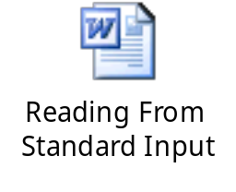
Reading From Standard Input
Let us understand how to read the String information from the console standard input by using the embedded document.

Slide 10
Simple Formatted Output
The printf() provides standard formatted output from the program. This enables programmers to migrate from legacy code.
The following table displays few common formatting codes.
Code | Description
%s | Formats the argument as a string, usually by calling the toString method on the object.
%d %o %x | Formats an integer, as a decimal, octal, or hexadecimal Value.
%f %g | Formats a floating point number. The %g code uses scientific notation.
%n | Inserts a newline character to the string or stream.
%% | Inserts the % character to the string or stream.

Slide 11
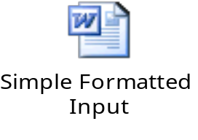
Simple Formatted Input
The Scanner class of java.util package provides formatted input functionality.
It provides methods for getting primitive values and strings and blocks as it waits for input from the user.
Let us understand how to use the Scanner class by using the embedded document.

Slide 12
Files and File I/O
The java.io package enables you to:
  Create File objects.
  Manipulate File objects.
  Read and write to file streams.

Slide 13
Creating a New File Object
The File class provides several utilities for handling files and obtaining information about them.
The following code snippet creates a new File object:
File myFile;
myFile = new File("myfile.txt");
or
  myFile = new File("MyDocs", "myfile.txt");
Directories are treated just like files in Java.
The following code snippet displays File class that supports methods for retrieving an array of files in the directory:
  File myDir = new File("MyDocs");
  myFile = new File(myDir, "myfile.txt");

Slide 14
The File Tests and Utilities
The following table lists the methods that can be used to gather information about the file after the File object is created.
Section | Section Description | Method Name
File Names | Return file names | String getName() String getPath() String getAbsolutePath() String getParent() boolean renameTo(File newName)
Directory Utilities | Provide directory utilities | boolean mkdir() String[] list()
General File Information and Utilities | Return general file information | long lastModified() long length() boolean delete()
File Tests | Return information about file attributes | boolean exists() boolean canWrite() boolean canRead() boolean isFile() boolean isDirectory() boolean isAbsolute() boolean isHidden()

Slide 15
File Stream I/O
Java supports file input in two forms:
  Use the FileReader class to read characters.
  Use the BufferedReader class to use the readLine() method.
Java supports file output in two forms:
  Use the FileWriter class to write characters.
  Use the PrintWriter class to use the print() and println() methods.

Slide 16
What Are the Java Foundation Classes (JFC)?
Java Foundation Classes (JFC):
  Is a set of Graphical User Interface (GUI) support packages that are available as part of the Java SE platform.
  Became a core Application Program Interfaces (APIs) in JDK 1.2.
JFC includes the following features:
  The Swing component set
  2D graphics
  Pluggable look-and-feel
  Accessibility
  Drag-and-drop
  Internationalization

Slide 17
What Is Swing?
Swing is an enhanced component set that provides replacement components for those in the original AWT and a number of more advanced components.
These components enable a programmer to create user interfaces with the help of various components, such as trees, tables, advanced text editors, and tear-off toolbars.

Slide 18
Pluggable Look-and-Feel
Pluggable look-and-feel enables developers to build applications that execute on any platform as if they were developed for that specific platform.
Pluggable look-and-feel provided by the Swing components is facilitated by their underlying architecture.

Slide 19
Swing Architecture
Swing components are designed based on the Model-View-Controller (MVC) architecture.
According to the MVC architecture, a component can be modeled as three separate parts:
  Model: It stores the data used to define the component.
  View: It represents the visual display of the component. This display is governed by the data in the model.
  Controller: It deals with the behavior of the components when a user interacts with it. This behavior can include any updates to the model or view.

Slide 20
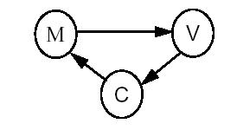
Swing Architecture (Contd.)
The following figure displays the MVC architecture.
The Swing components follow a separable model architecture.
In this architecture, the view and the controller are merged as a single composite object, because of their tight dependency on each other.
The model object is treated as a separate object just like in MVC architecture.

Slide 21
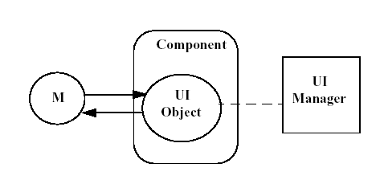
Swing Architecture (Contd.)
The following figure displays the separable model architecture.

Slide 22
Swing Packages
The Swing API has a rich and convenient set of packages that makes it powerful and flexible.
Some of the packages are:
  javax.swing
  javax.swing.event
  javax.swing.table
  javax.swing.plaf
  javax.swing.tree
  javax.swing.border

Slide 23
Examining the Composition of a Java Technology GUI
A Swing API-based GUI is composed of the following elements:
  Containers: They are on top of the GUI containment hierarchy. All the components in the GUI are added to these containers. Jframe, JDialog, JWindow, and JApplet are the top-level containers.
  Components: They are derived from the JComponent class. JComboBox, JAbstractButton, and JTextComponent are few examples of components.
  Layout Managers: They are responsible for laying out components in a container. BorderLayout, FlowLayout, GridLayout are few examples of the layout managers.

Slide 24
Swing Containers
The three main categories of Swing containers are:
  Top-level
  General-purpose
  Special-purpose

Slide 25
Top-level Containers
Top-level containers are at the top of the Swing containment hierarchy.
The three top-level Swing containers are:
  JFrame
  Jwindow
  JDialog

Slide 26
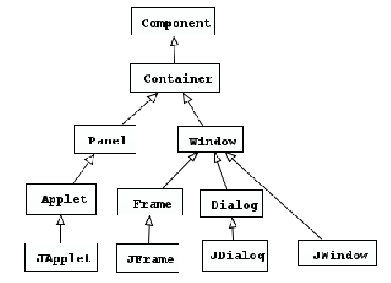
Top-level Containers (Contd.)
The following figure displays the inheritance hierarchy of the top-level containers.

Slide 27
Swing Components
Swing components can be broadly classified as:
  Buttons
  Text components
  Uneditable information display components
  Menus
  Formatted display components
  Other basic controls

Slide 28
The Swing Component Hierarchy
  Some of the components of the Swing JComponent class are:
  JTextComponent
  JPanel
  JLabel
  JList
  JTable
  JTree
  JMenuBar
  JScrollBar
  JSplitPane
  JRootPane
  JComboBox

Slide 29
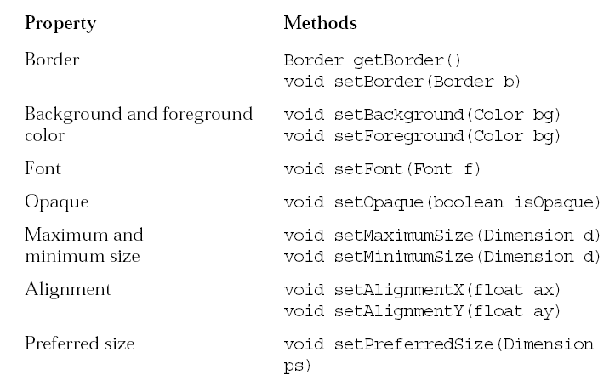
Properties of Swing Components
All the Swing components share some common properties because they all extend the Jcomponent class.
The following figure displays a subset of the common properties that all Swing components inherit from Jcomponent.

Slide 30
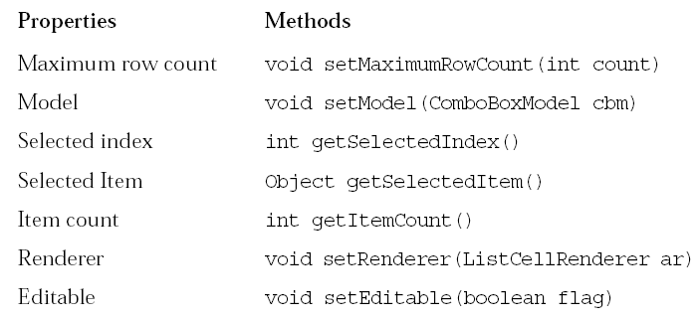
Properties of Swing Components (Contd.)
The following figure displays some properties specific to JComboBox.

Slide 31
Summary
In this session, you learned that:
  InputStreamReader and OutputStreamWriter classes are used to interface between byte streams and character readers and writers.
  The BufferedReader and BufferedWriter class filter character streams are used to increase the efficiency of I/O operations.
  Java supports console I/O with three public variables in the java.lang.System class:
    System.out
    System.in
    System.err
  The System.out.println(String) method is used to write standard output.

Slide 32
Summary (Contd.)
  The printf() provides standard formatted output from the program. This enables programmers to migrate from legacy code.
  The Scanner class of java.util package provides formatted input functionality.
  The java.io package enables you to:
    Create File objects.
    Manipulate File objects.
    Read and write to file streams
  The File class provides several utilities for handling files and obtaining information about them.

Slide 33
Summary (Contd.)
  Java Foundation Classes (JFC):
    Is a set of Graphical User Interface (GUI) support packages that are available as part of the Java SE platform.
    Became a core Application Program Interfaces (APIs) in JDK 1.2.
  Swing is an enhanced component set that provides replacement components for those in the original AWT and a number of more advanced components.
  Swing components are designed based on the Model-View-Controller (MVC) architecture.
  A Swing API-based GUI is composed of the following elements:
    Containers
    Components
    Layout Managers

Slide 34
Summary (Contd.)
  The three main categories of Swing containers are:
    Top-level
    General-purpose
    Special-purpose
  The three top-level Swing containers are:
    JFrame
    Jwindow
    Jdialog

